Slide 1
Week 5 – Hands-on tutorial
Data Clustering using RapidMiner

Slide 2
RapidMiner - Auto Model
Auto Model is a function of RapidMiner which can make your data analytics easier.
Auto Model is part of RapidMiner Studio that accelerates the process of building and validating models.
Auto Model addresses three types of problems:
1. Predict : Want to predict the values of a column?
2. Clusters: Want to identify groups in your data?
3. Outliers: Want to detect outliers in your data?
Auto Model helps you not only get results but also understand those results.

Slide 3
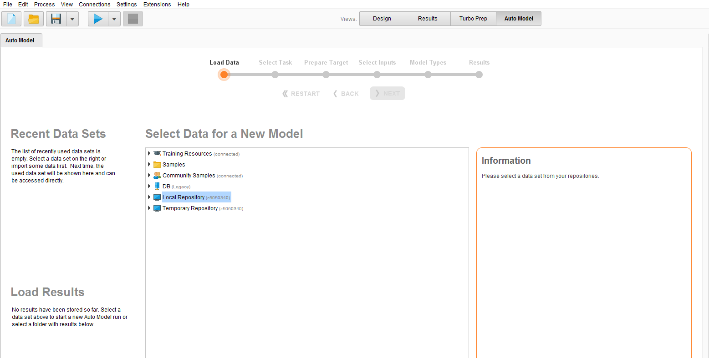
RapidMiner - Auto Model
Auto Model

Slide 4
Example: Financial advising company
Clustering data of a Financial advising company (known as KTC dataset).
Please read Chapter 4 (page 141) for more information of this example.
KTC data is provided to you on the course Moodle website.

Slide 5

Select Data
After starting Auto Model, the first step is to select a dataset from one of your repositories.
For this presentation:
First download the KTC dataset from Moodle website.
Then import it: Click on --> Where your data is

Slide 6
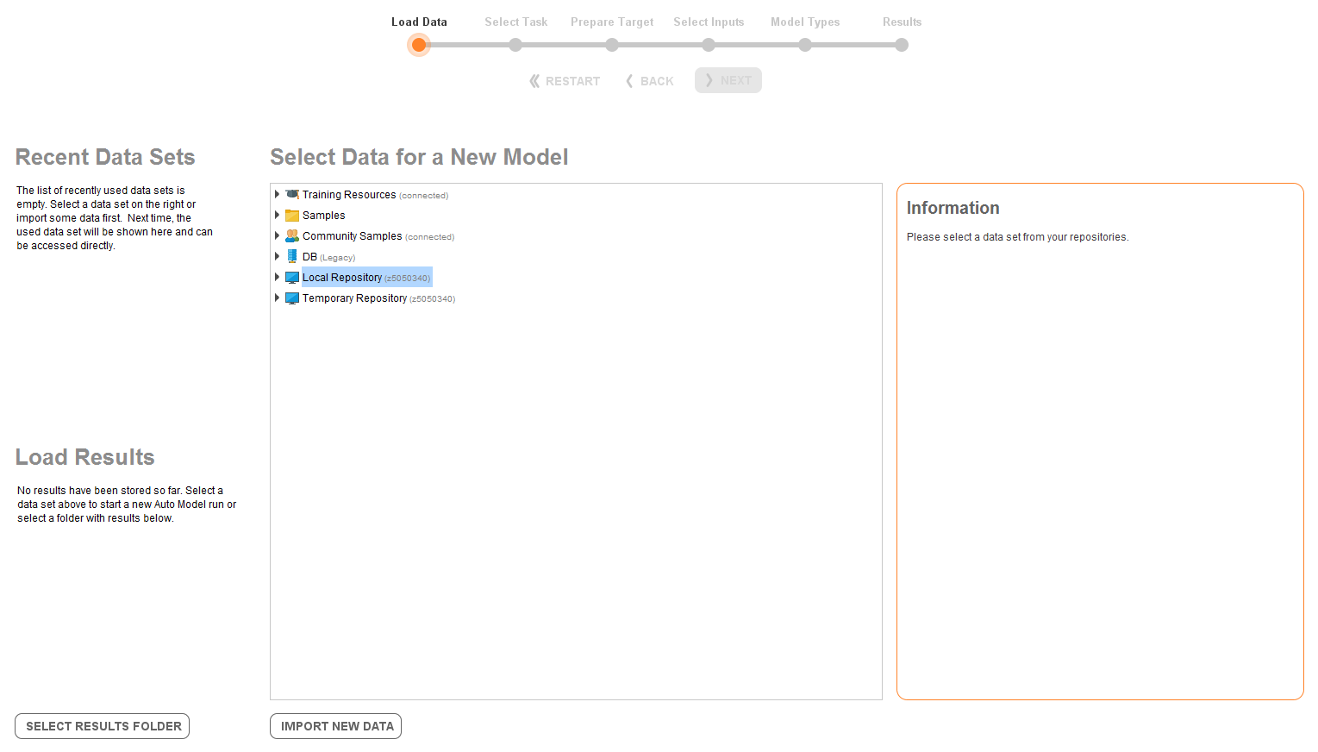
Select Data
Import new data

Slide 7
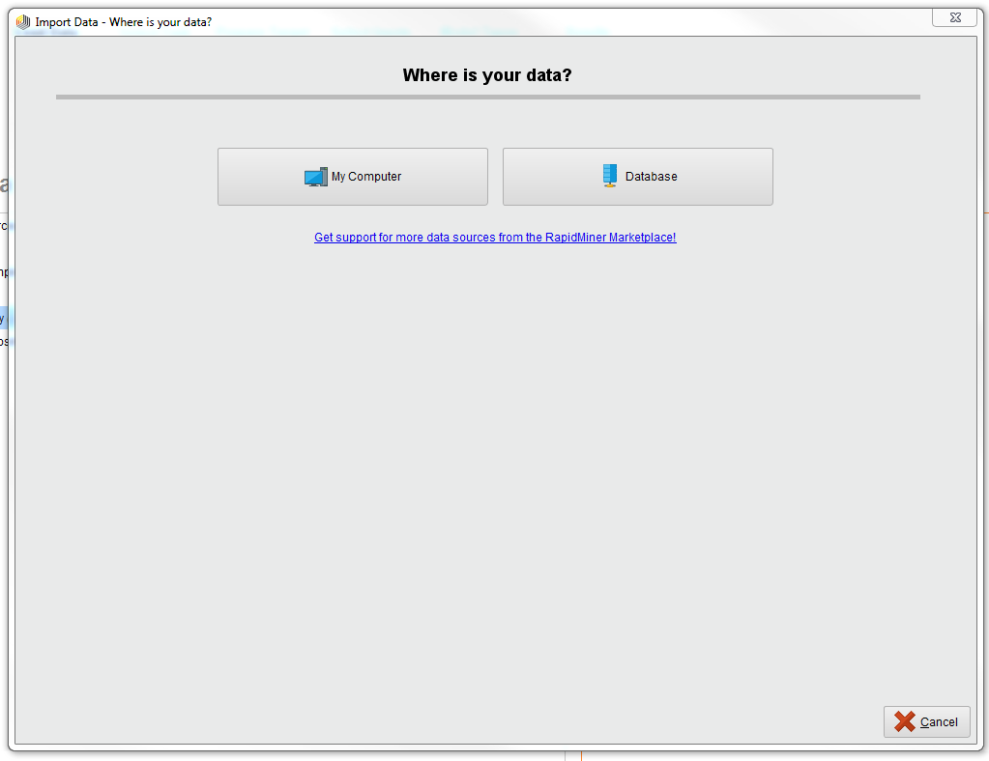
Select Data
Find the downloaded KTC dataset in your computer

Slide 8
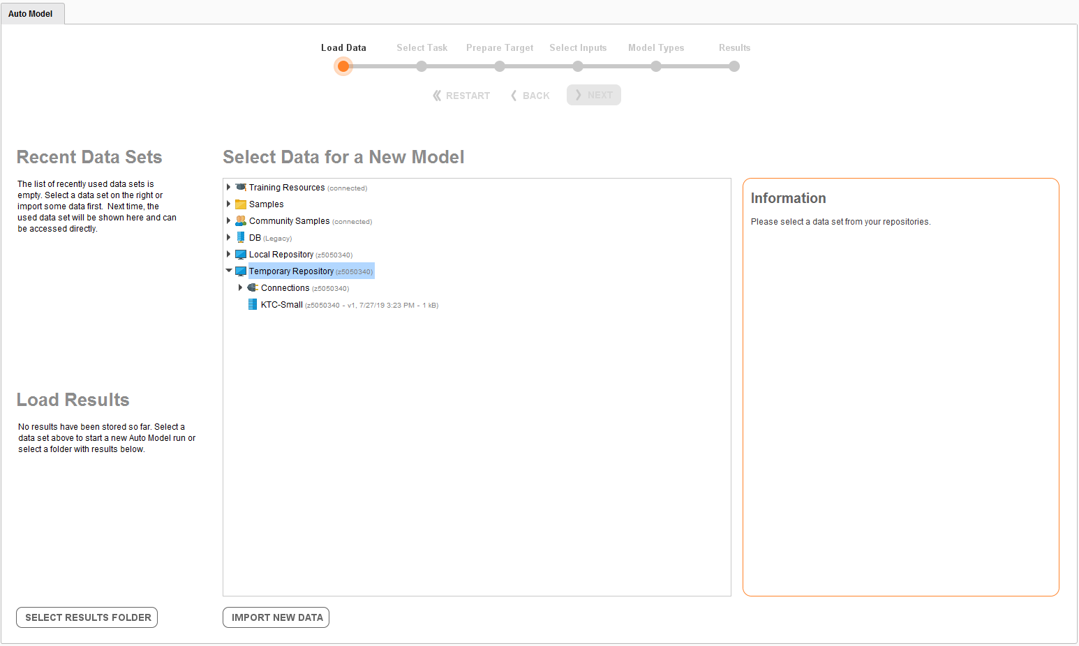
Select Data
Now, the KTC dataset has been stored under the Temporary Repository.

Slide 9
Descriptive statistic with RapidMiner

Slide 10
Descriptive statistic
Numerical attributes: mean, median, minimum, maximum, standard deviation, and number of missing values.
Nominal/categorical attributes: number of categories, counts, mode, number of missing values.
Date attributes: minimum, maximum, number of missing values.

Slide 11

Descriptive statistic
Right-click on the targeted dataset then choose ‘open’, the new windows will pop up under Results Tab.
You can see Descriptive Statistic when clicking on the tatisti button to the left side of the window.

Slide 12
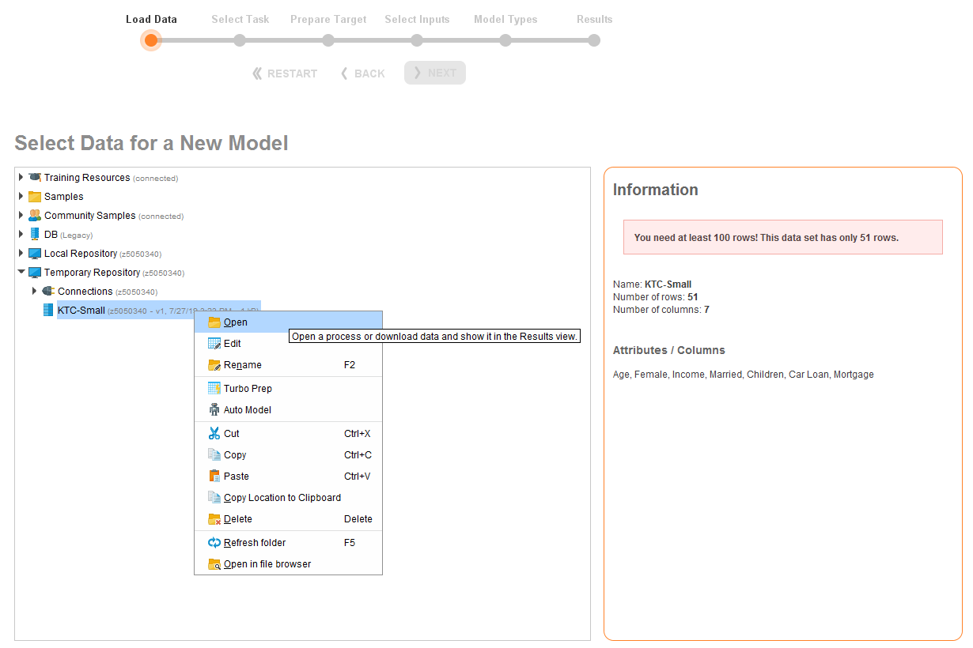
Descriptive statistic
Right-click, then open

Slide 13
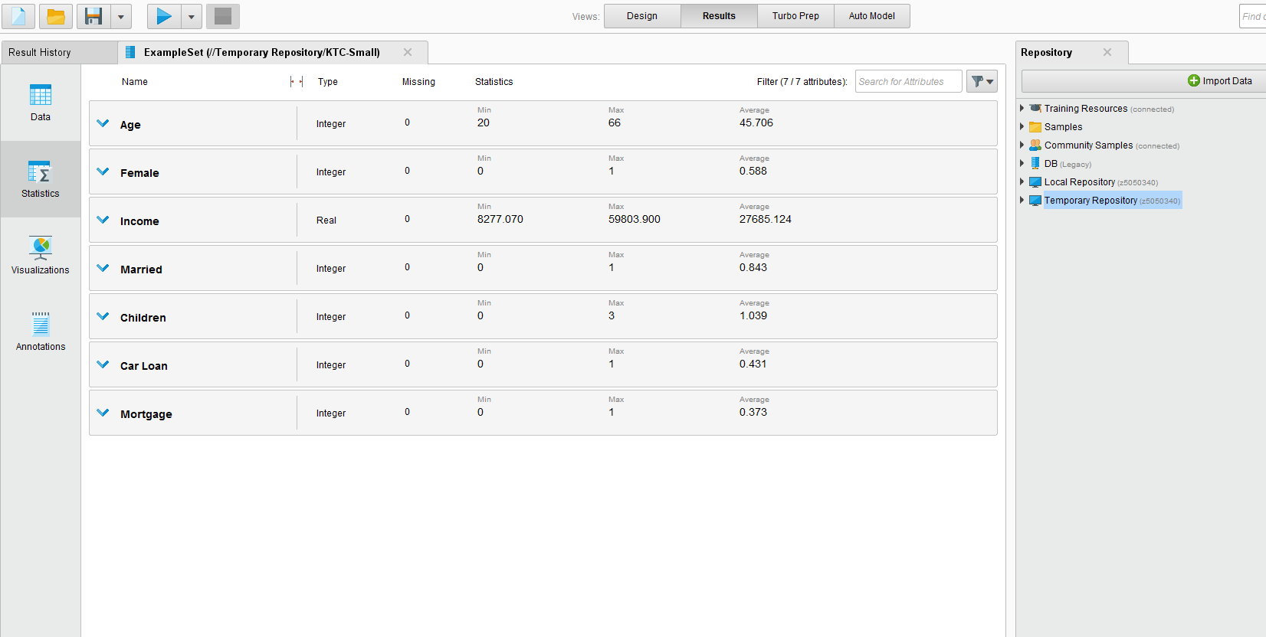
Descriptive statistic
Statistics
Results

Slide 14
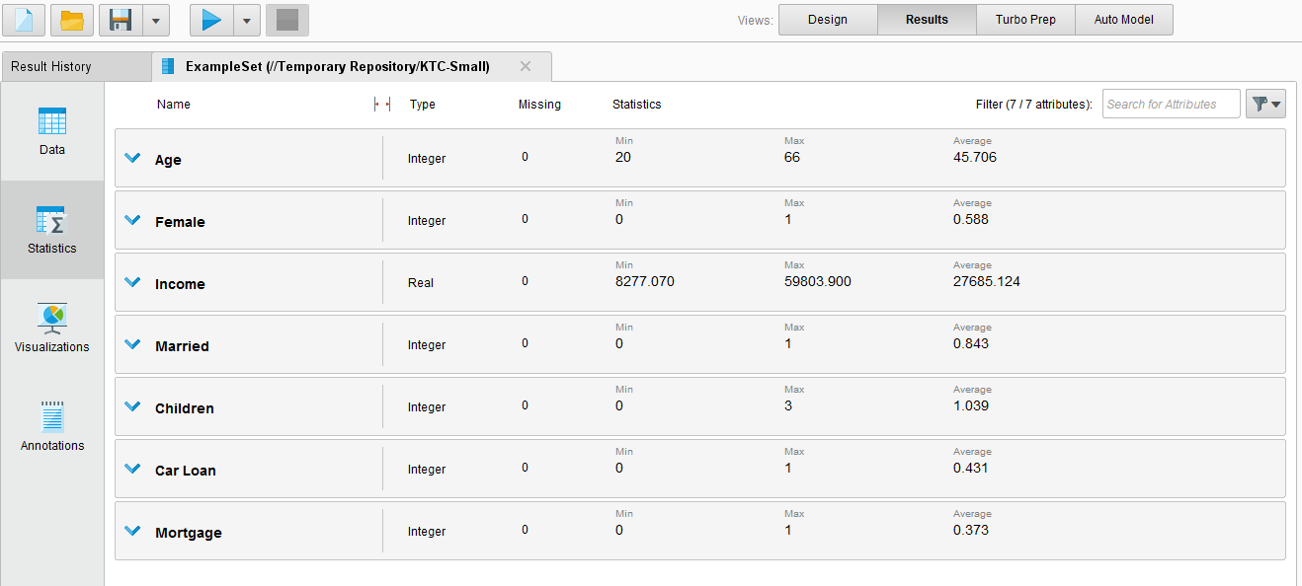
Descriptive statistic
Type
Missing
Statistics

Slide 15
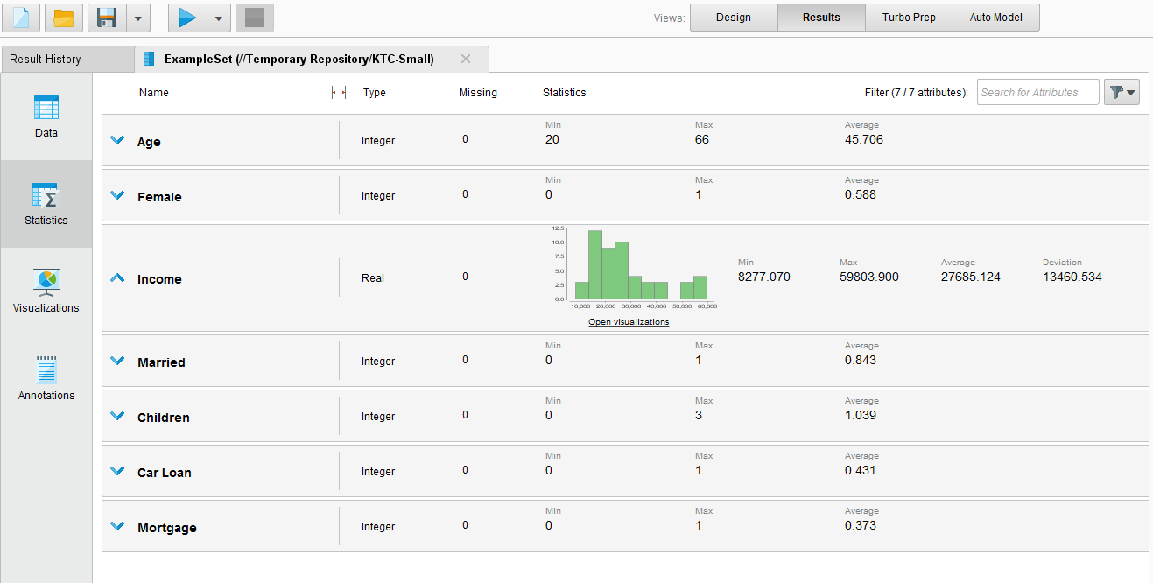
Descriptive statistic
Clicking on any row for showing frequency distribution

Slide 16
Clustering

Slide 17

Select task
For selecting data analyzing tasks, one has to decide what kind of problem that needs to be solved. Auto Model identifies three different problems:
1. Predict
2. Clusters
3. Outliers
In our case, we want to cluster KTC data.

Slide 18
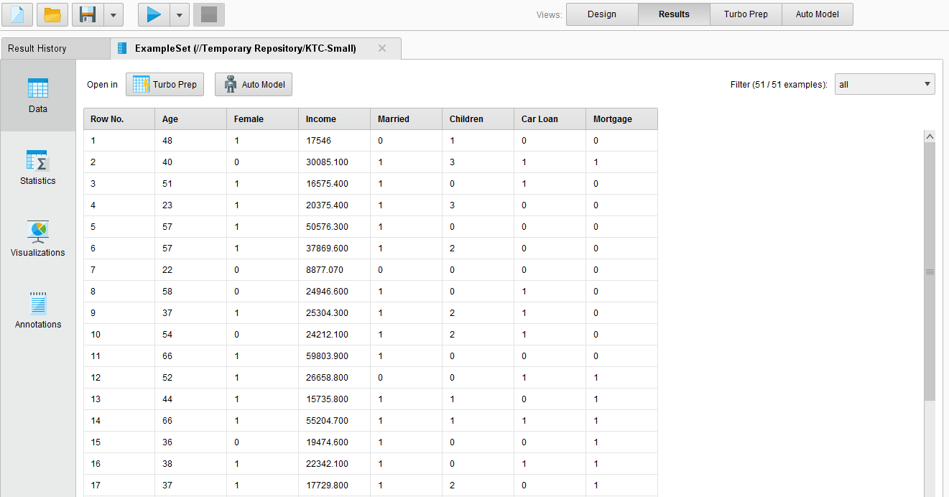
Select task
In order to switch back to Auto Model from Results tab, click on ‘Data’.
Then click on ‘Auto Model’.
Notes:
Technological advances such as the improved point-of-sale scanner technology and the collection of data through e-commerce.

Slide 19
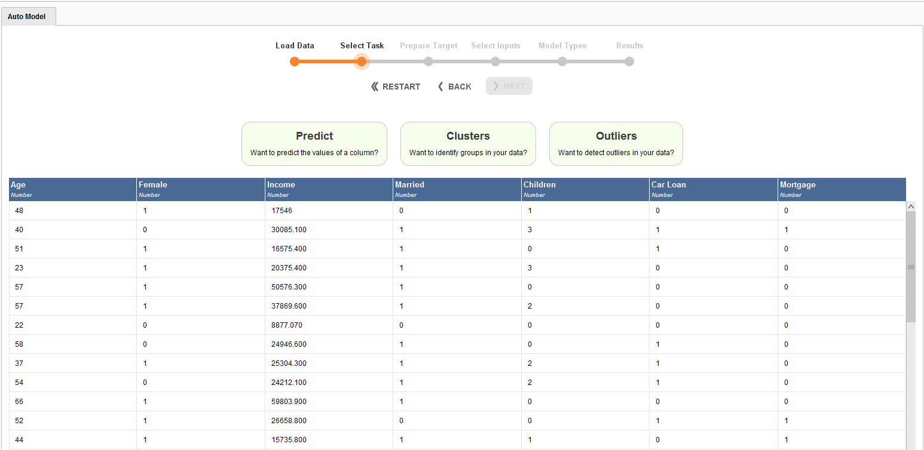
Select task
Clusters

Slide 20
Select pairs of variables
For a better result demonstration, we do clustering by considering pairs of variables. Therefore, we should nominate pairs which can be done using a correlation function.
In the next slides, we show how you can obtain the correlation values between pairs of inputs.

Slide 21
Select pairs of variables
1. Choose all inputs.
2. Run k-means and x-means.
3. Under General, see correlation.
4. Choose pair(s) with highest correlation values.

Slide 22
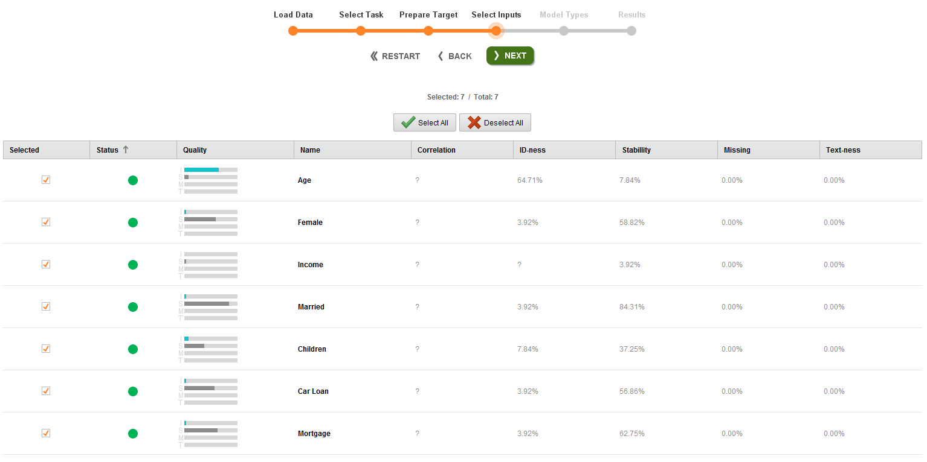
Select pairs of variables
Select all inputs, then click ‘NEXT’

Slide 23
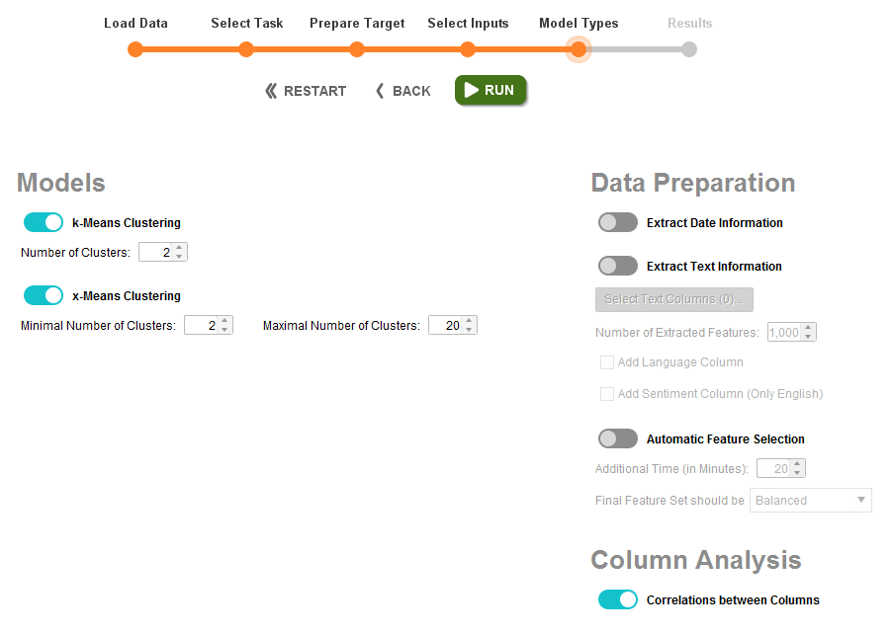
Select pairs of variables
Set ‘k=2’, then click ‘RUN’.

Slide 24
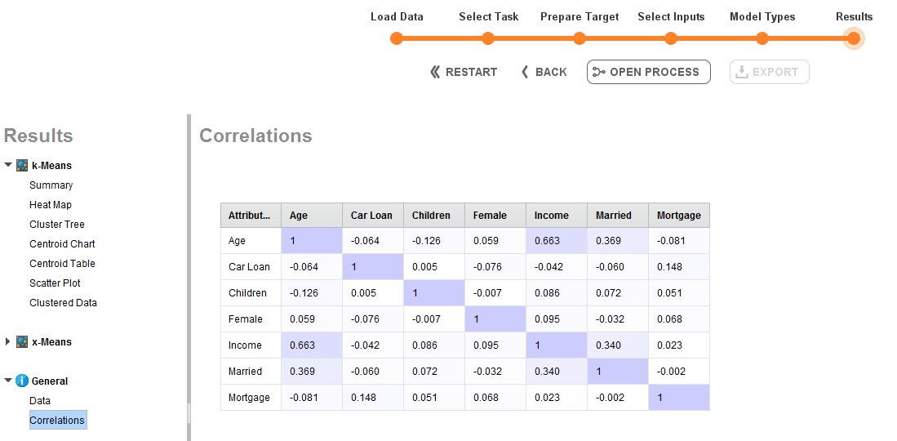
Select pairs of variables
Age & Married : 0.369
Age & Income : 0.663

Slide 25
Select pairs of variables
For a better result demonstration, we do clustering by considering pairs of variables using the correlation function. Two highest correlation values in the results are:
Age & Income : 0.66
Age & Married : 0.36

Slide 26
Clustering models

Slide 27
Clustering models
The Auto Model provides you with two clustering models:
K-means
X-means
In fact, X-means is one type of K-means models which automatically finds the optimum number of clusters.

Slide 28
Clustering models
Choosing and setting models

Slide 29
The optimum number of clusters
In general, the larger the ratio of the distance between a pair of cluster centroids and the within-cluster distance, the more distinct the clustering is for the observations in the two clusters in the pair. X-means can be used for this purpose.
X-Means is a clustering algorithm which determines the correct number of centroids based on a heuristic. It begins with a minimum set of centroids and then iteratively exploits if using more centroids makes sense according to the data.

Slide 30
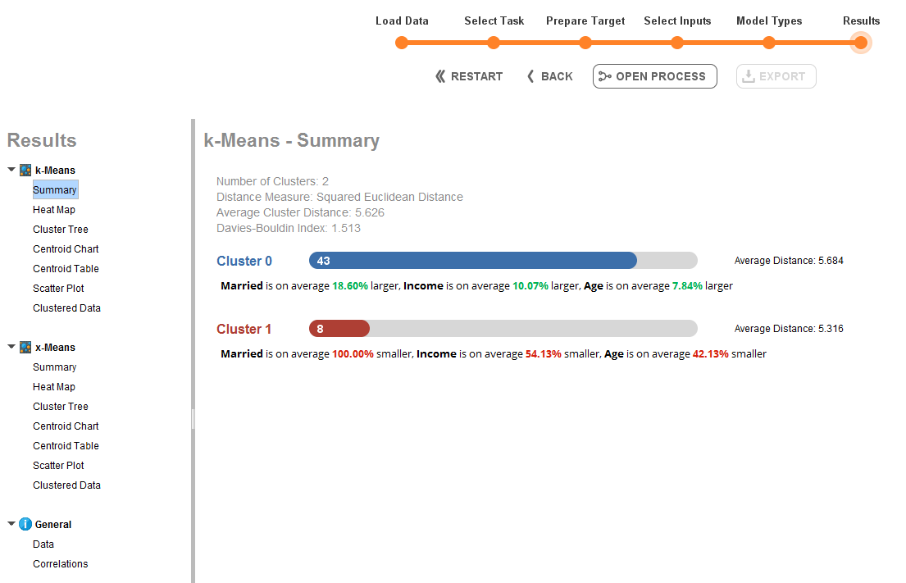
The optimum number of clusters
K-Means and x-Means
X-Means is a clustering model in RapidMiner which can be used when we are not sure what the best value for K is.

Slide 31
Clustering Results

Slide 32
Clustering results
Now, let us have a trial on the KTC dataset using the Auto Model, and see what results RapidMiner can provide.
The variables ‘age’ and ‘income’ in the KTC dataset are used for this trial.

Slide 33
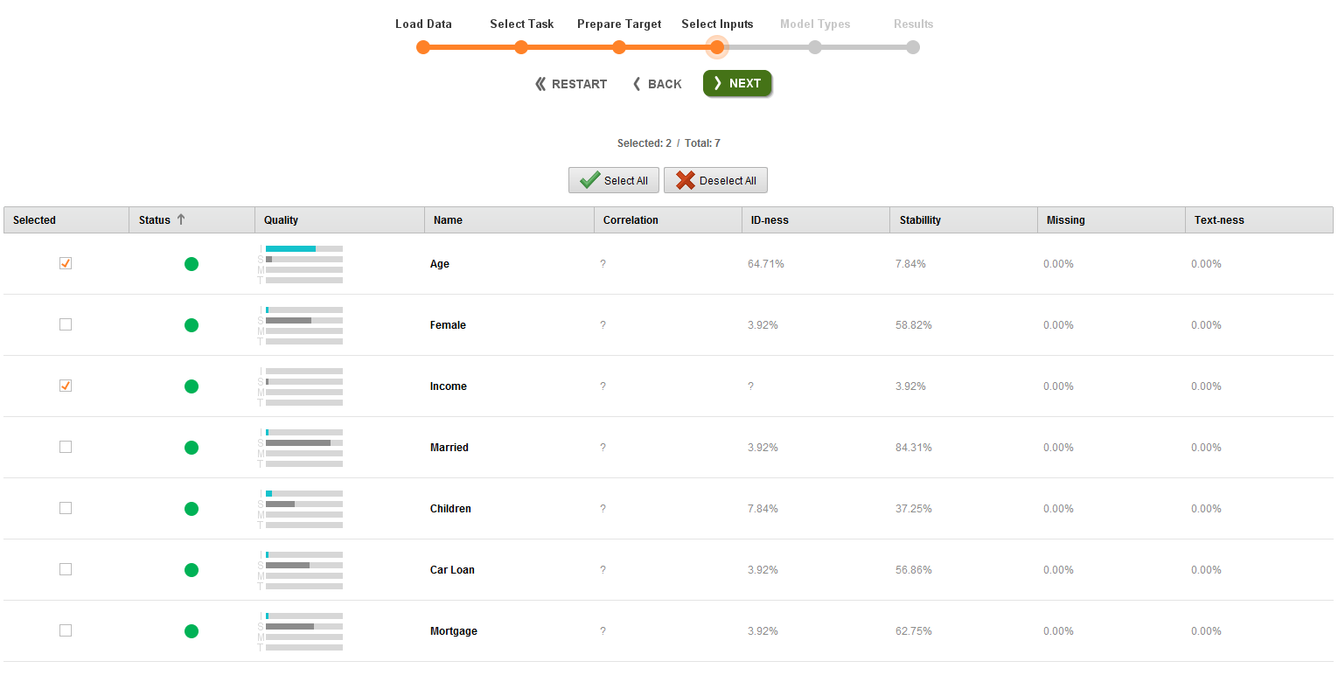
Clustering results
Back to the stage ‘Select Input’
Instead of selecting all inputs, this trial chooses only ‘age’ and ‘income’.

Slide 34
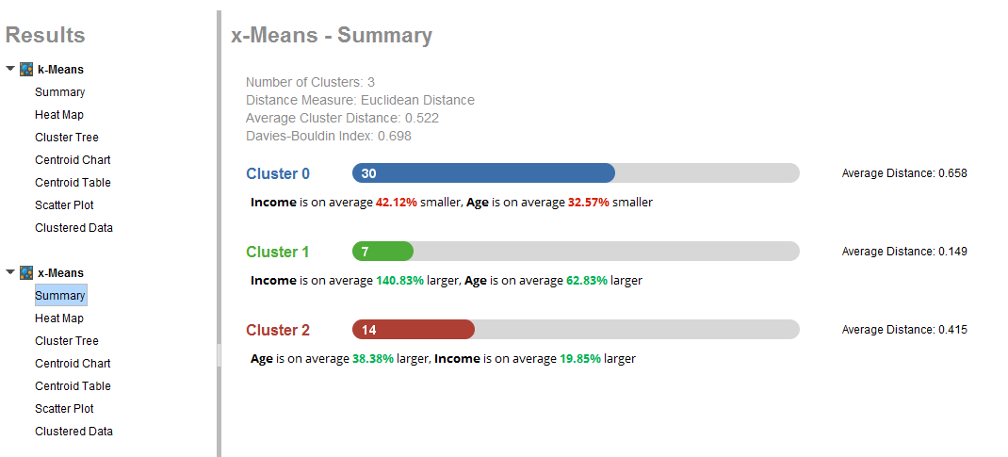
Clustering results
X-means is suggesting three clusters.
The textbook (page 148) states that 3 clusters is a good fit with this data, and RapidMiner generates the same result. You see how x-means is helpful!!

Slide 35
Clustering results
Cluster 0: relatively younger, lower-income
Cluster 1: relatively older, higher-income
Cluster 2: relatively older, lower-income

Slide 36
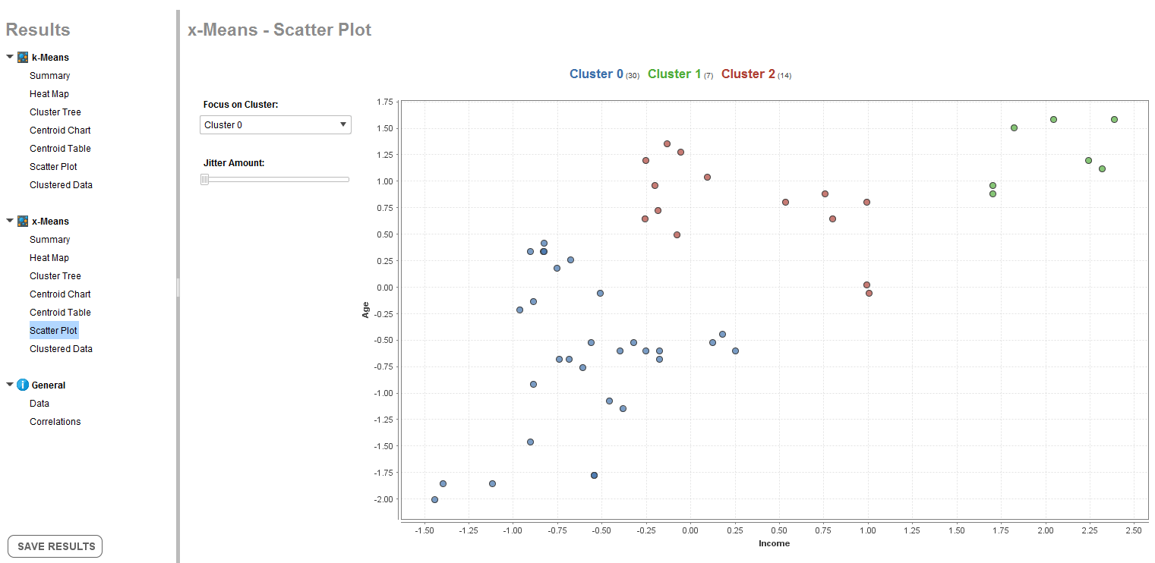
Clustering results – Scatter chart
Cluster 0’s size is 30
Cluster 1
Cluster 2
Cluster 0

Slide 37
Clustering results – Heat map
Heat maps originated in 2D displays of the values in a data matrix.
Larger values were represented by dark green and smaller values by lighter red.
The three clusters are represented in the next slide within a heat map.

Slide 38
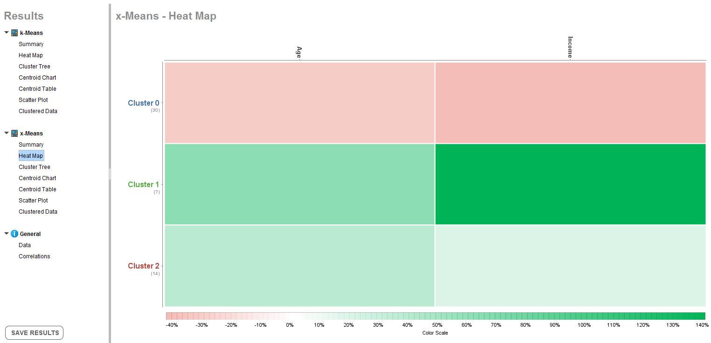
Clustering results – Heat map
Age
Income

Slide 39
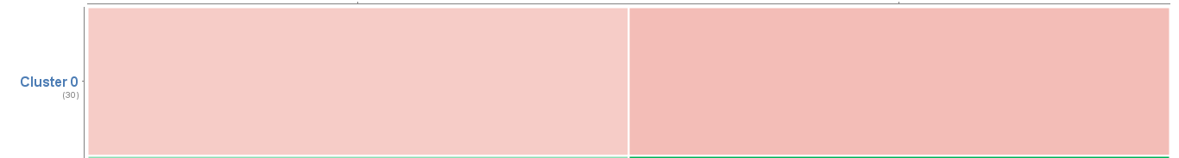
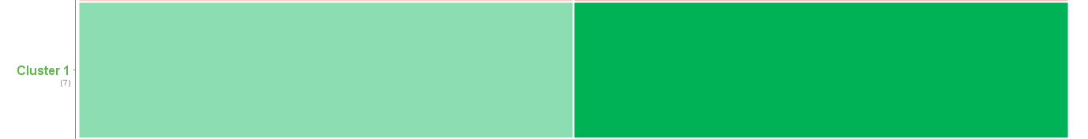
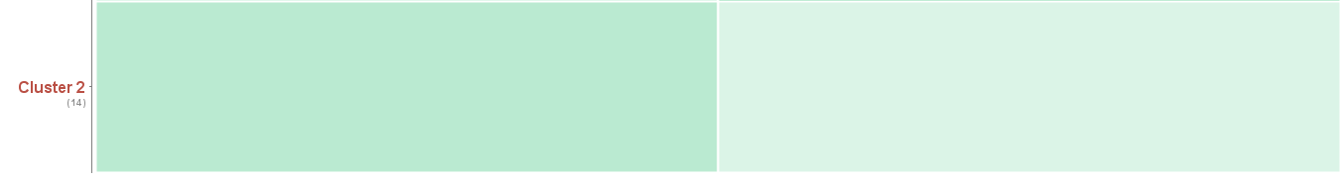
Clustering results – Heat map
Age
Income
Relatively older
Higher income
Relatively younger
Lower income
Relatively older
Lower income

Slide 40
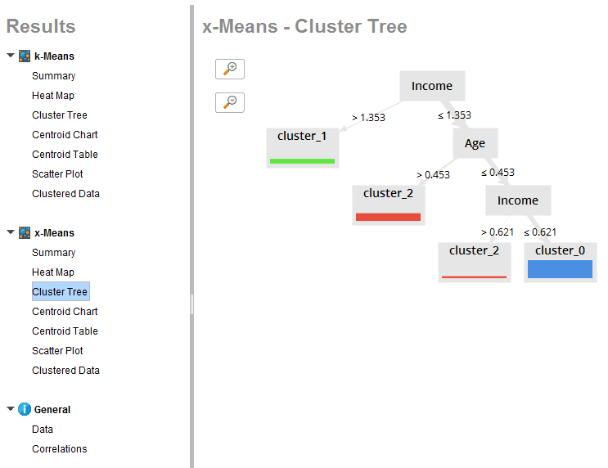
Clustering results – Cluster tree

Slide 41
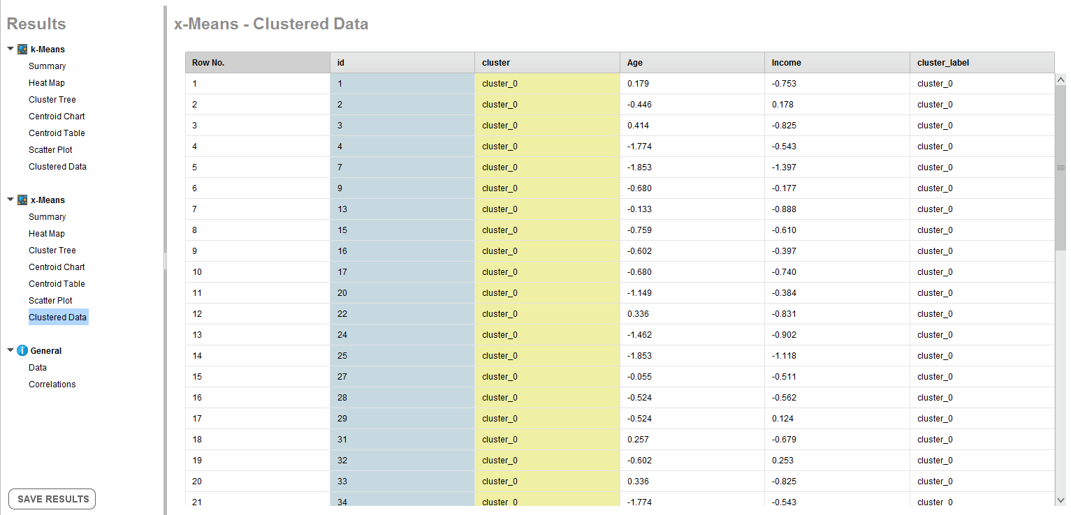
Clustering results – Clustered data
Clustered data shows to which cluster each row is belonging.

Slide 42
Conclusion and Notes
In this week, we mainly focus on Clustering.
Reading this file while working with RapidMiner is strongly recommended.
It helps you a lot to do the Second Assignment.

